Slide 1
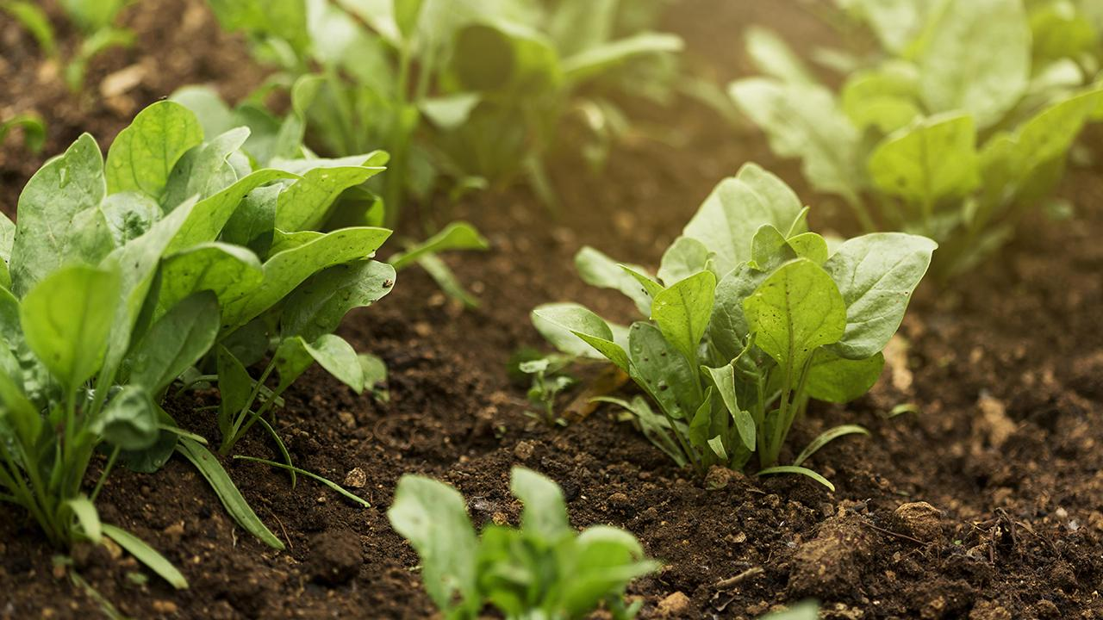
Integrated Farming
Sensor System

Slide 2

TEAM MEMBERS:
BHUMIKA.S -20BEC1100
KARTHIKEYAN S-20BEC1241
ABRAHAM KURIAKOSE-20BRS1119
VIJESH KUMAR S -20BEC1314

Slide 3
ABSTRACT:
Agriculture is the main source for growth and development of economy and a plays a crucial role in variety of industrial sectors. Unfortunately, farmers are still dependent on traditional methods which has poor yields and other drawbacks. Modern day farming demands increased production of food to accommodate the large global population. The alarming climate change and scarcity of water demand improved methods for agriculture. There is a need to shift towards automated farming systems based on sensors which can be used to integrate informations corresponding to the ideal farming conditions and to use the output data for analysis and management. This sensor based system contains channels for responding to the sensor outputs and can improve crop growth from the farms. This proposed system consists of sensors like soil moisture sensor, humidity sensor, pH sensor and temperature sensor. These sensors collects the present soil moisture, humidity, soil pH and temperature of the surrounding. The project aims at integrating traditional farming and modern techniques to reduce the manual monitoring of soil testing and irrigation and help farmers in increasing the agricultural production. The main purpose of this system is to increase the agricultural yield and reduces the investments in soil monitoring and irrigation.

Slide 4
Block diagram
ARDUINO UNO
(Micro-controller board)
Relay
Irrigation channels
Soil moisture
Sensor
Digital
Screen
(Display)
Temperature
Sensor
Humidity
Sensor

Slide 5
working :
PIC16F877A
Microcontroller
Digital
Screen
(Display)
Ph sensor

Slide 6
COMPONENTS REQUIRED:
Arduino UNO
Arduino Uno is a micro controller-based development board ATmega328P . It has 14 digital input/output pins ,6 analog inputs, a USB connector, and a reset button. It contains everything needed to support the microcontroller to perform various operations. It has a 32kb of flash memory to store the program that can be coded for the operation.
Temperature sensor
LM35 is an Integrated temperature sensor specially designed for measuring the surrounding temperature. the main advantage of this is the output is directly proportional to the surrounding temperature hence its accuracy is more compare to the thermistor. Its self heating is about 0.1 °C hence power consumed will be less.
Soil Moisture Sensor
Soil moistures sensors are mainly used for the volumetric analysis of the moisture present in the soil. Which helps in the suitable irrigation of plants. It increases the quality and yield of the crop, by providing the required amount of water using relays through microcontroller.

Slide 7
4) Humidity sensor
A humidity sensor measures moisture content present in the air. The amount of moisture present depends on the air temperature. The humidity changes with change in air temperature Which is important factor to increase the yield by looking into other surrounding parameters.
5) pH Sensor
A pH sensor consist of electrodes which measures the concentration of hydrogen ions, which indicates whether the soil is acidic or alkaline.
6) AC MOTOR
An electric motor uses electric energy to produce mechanical energy.
7) Relay
A simple relay is used to open or close a circuit. It can energize and de-energize the system according to the inputs (typical to an actuator).

Slide 8
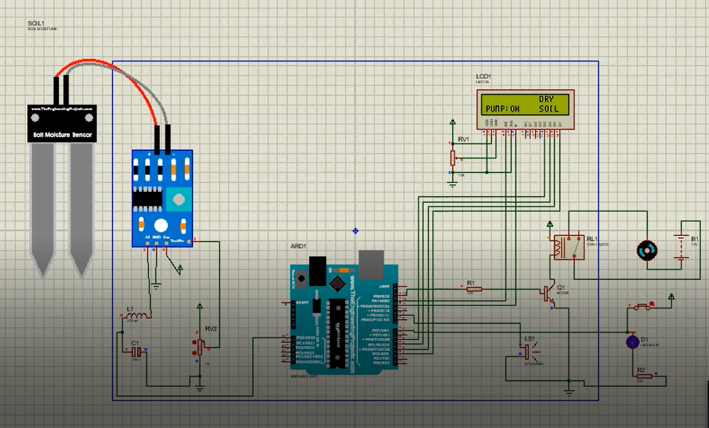
PROPOSED CIRCUITS IN REVIEW 2:

Slide 9
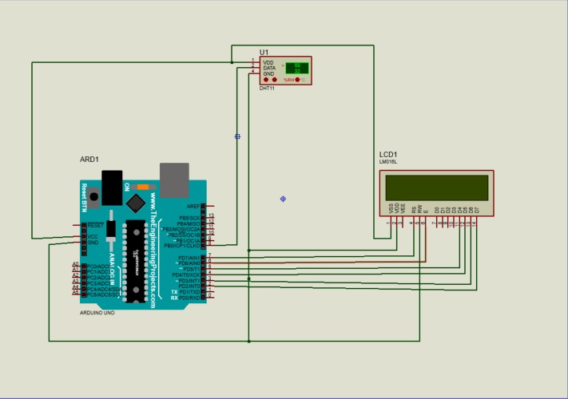

Slide 10
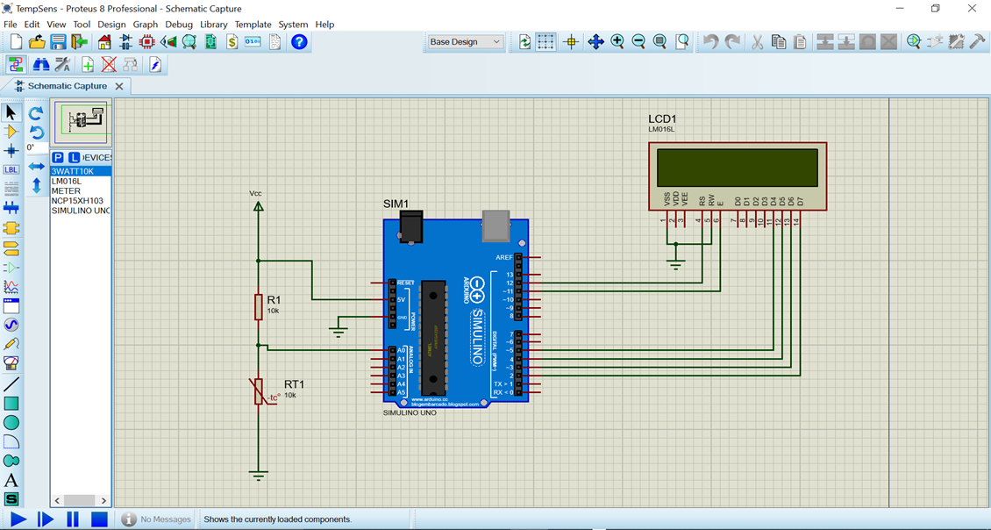

Slide 11
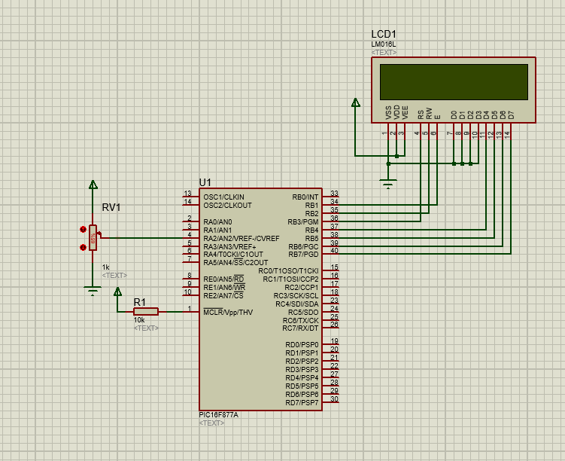
Working of the pH sensor:

Slide 12
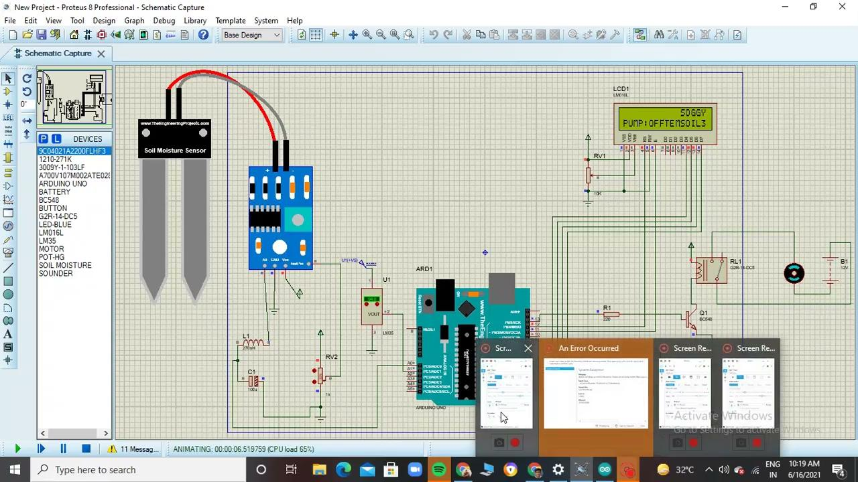
Working :

Slide 13
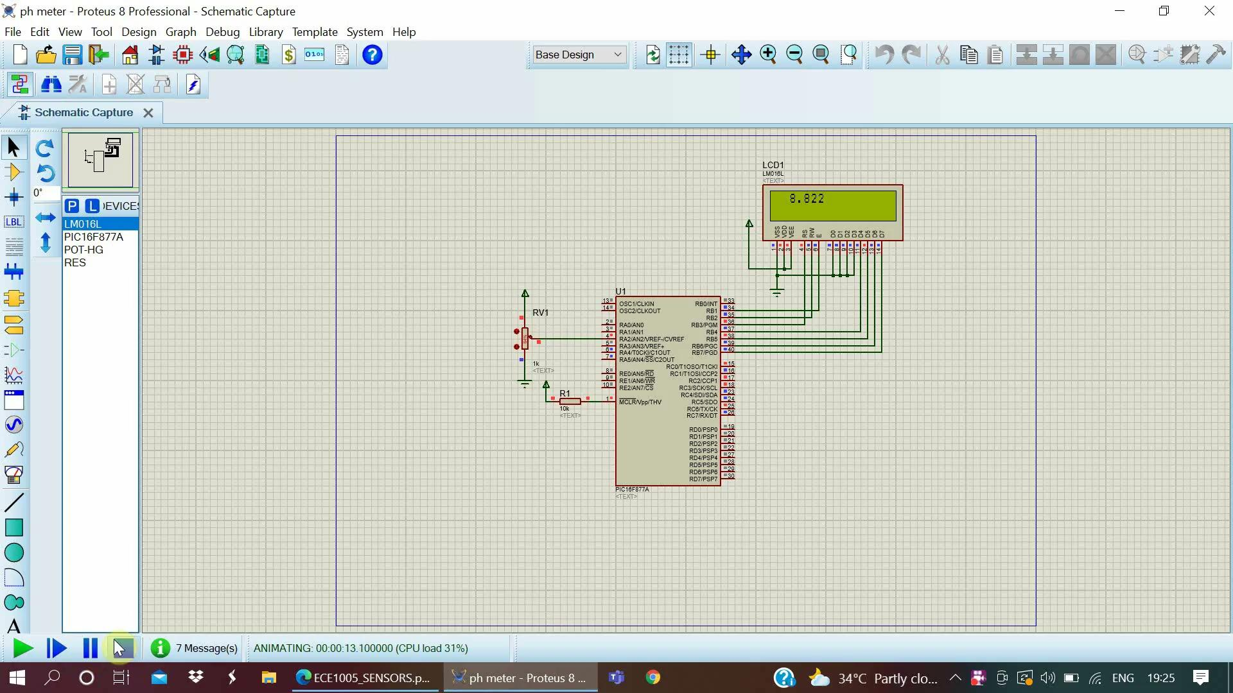

Slide 14
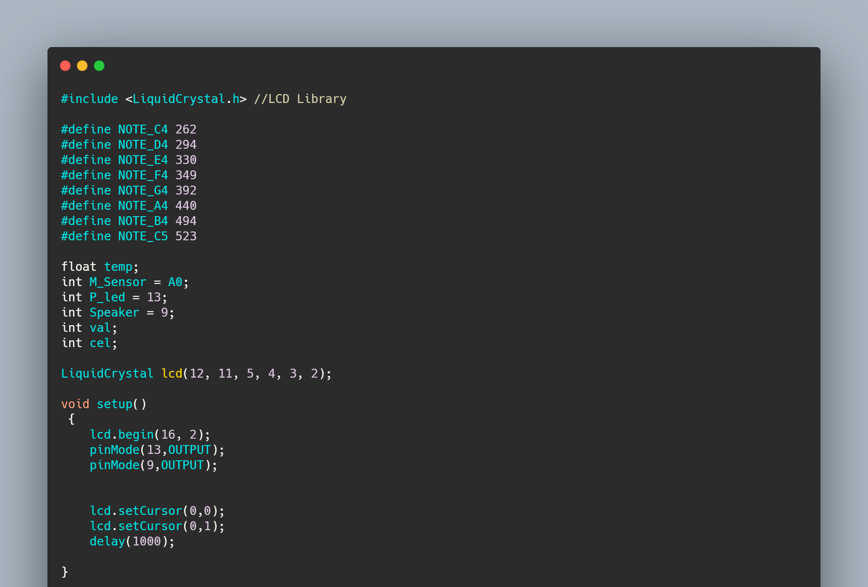

Slide 15
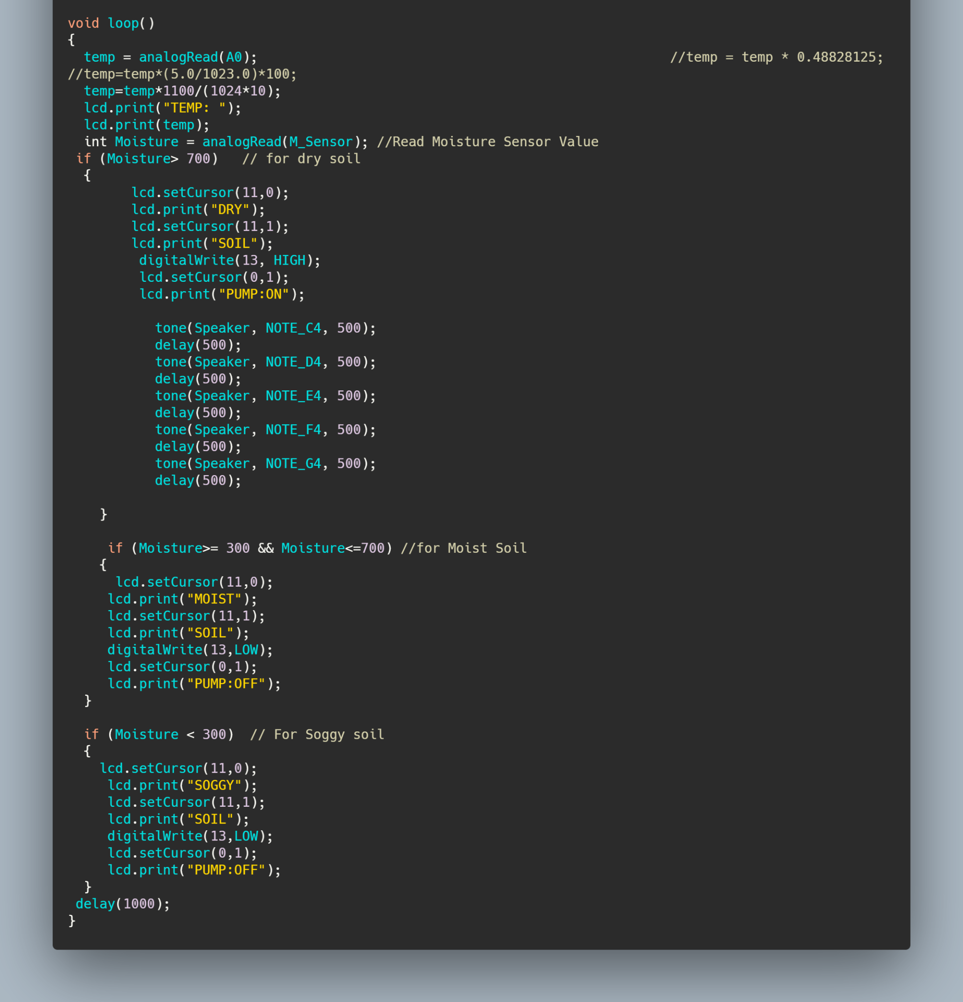

Slide 16
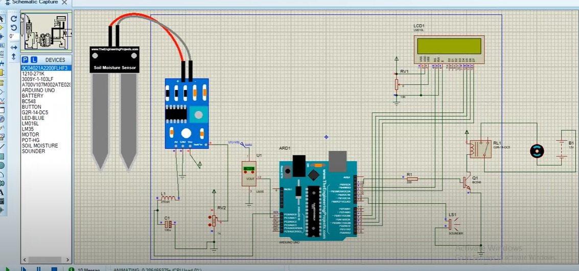
FINAL WORKING MODEL:

Slide 17

FINAL WORKING MODEL:

Slide 18
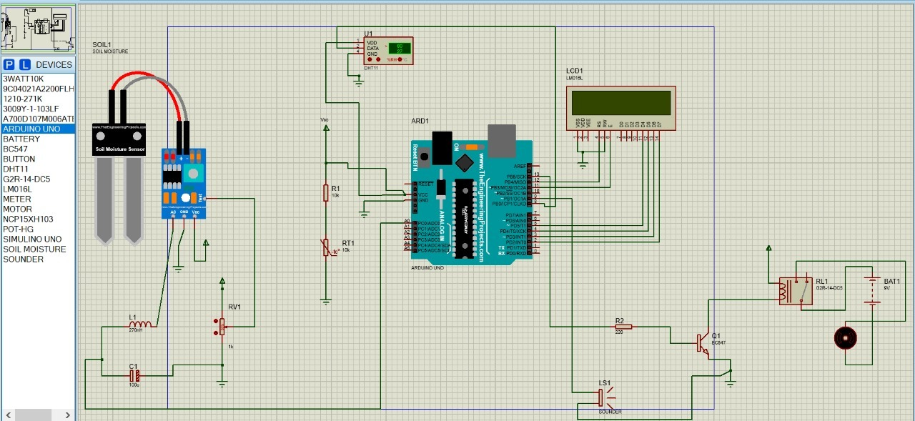
FINAL WORKING MODEL:

Slide 19
Code:
#include <LiquidCrystal.h>
#include <DHT.h>
#define DHTPIN 8
int THERMISTORPIN = 1, BCOEFFICIENT = 3380 ;
float THERMISTORNOMINAL = 10000 , TEMPERATURENOMINAL = 25 , SERIESRESISTOR = 10000 ;

Slide 20
#define NOTE_C4 262
#define NOTE_D4 294
#define NOTE_E4 330
#define NOTE_F4 349
#define NOTE_G4 392
#define NOTE_A4 440
#define NOTE_B4 494
#define NOTE_C5 523
int temp;
int M_Sensor = A0;

Slide 21
int P_led = 13;
int Speaker = 9;
int val;
int cel;
LiquidCrystal lcd(12, 11, 5, 4, 3, 2);
#define DHTTYPE DHT11
DHT dht(DHTPIN, DHTTYPE);
int sample[5];
void setup() {
lcd.begin(16, 2);

Slide 22
dht.begin();
pinMode(13,OUTPUT);
pinMode(9,OUTPUT);
}
void loop() {
delay(500);
int Moisture = analogRead(M_Sensor); //Read Moisture Sensor Value
if (Moisture> 700) // for dry soil
{
lcd.setCursor(0,0);
lcd.print("DRY SOIL");
digitalWrite(13, HIGH);

Slide 23
lcd.setCursor(1,0);
lcd.print("PUMP ENGAGED");
tone(Speaker, NOTE_C4, 500);
delay(500);
tone(Speaker, NOTE_D4, 500);
delay(500);
tone(Speaker, NOTE_E4, 500);
delay(500);
tone(Speaker, NOTE_F4, 500);
delay(500);
tone(Speaker, NOTE_G4, 500);

Slide 24
delay(500);
delay(1000);
lcd.clear();
}
if (Moisture>= 300 && Moisture<=700) //for Moist Soil
{
lcd.setCursor(0,0);
lcd.print("MOIST SOIL");
digitalWrite(13,LOW);
lcd.setCursor(1,0);
lcd.print("PUMP:OFF");
delay(1000);

Slide 25
lcd.clear();
}
if (Moisture < 300) // For Soggy soil
{
lcd.setCursor(0,0);
lcd.print("SOGGY SOIL");
digitalWrite(13,LOW);
lcd.setCursor(1,0);
lcd.print("PUMP:OFF");
delay(1000);
lcd.clear();
}

Slide 26
int i;
float average;
for (i=0; i< 5; i++) {
sample[i] = analogRead(THERMISTORPIN);
delay(10);
}
average = 0;
for (i=0; i< 5; i++) {
average += sample[i];
}

Slide 27
average /= 5;
average = 1023 / average - 1;
average = SERIESRESISTOR / average;
float steinhart;
steinhart = average / THERMISTORNOMINAL; // (R/Ro)
steinhart = log(steinhart); // ln(R/Ro)
steinhart /= BCOEFFICIENT; // 1/B * ln(R/Ro)
steinhart += 1.0 / (TEMPERATURENOMINAL + 273.15); // + (1/To)
steinhart = 1.0 / steinhart; // Invert
steinhart -= 273.15; // convert to C
float h = dht.readHumidity();

Slide 28
if (isnan(h) || isnan(steinhart)) {
lcd.print("ERROR");
return;
}
else{
lcd.setCursor(0,0);
lcd.print("Temp:");
lcd.print(steinhart);
lcd.print("°C");

Slide 29
lcd.setCursor(1,0);
lcd.print("Humidity:");
lcd.print(h);
lcd.print("%");
}
Serial.print(steinhart);
Serial.print("\n");
Serial.print(h);
Serial.print("\n");
delay(1000);
}

Slide 30
SOIL MOISTURE SENSOR AND WORKING
Soil moistures sensors are mainly used for the volumetric analysis of the moisture present in the soil. Which helps in the suitable irrigation of plants. It increases the quality and yield of the crop, by providing the required amount of water using relays through microcontroller.
The working of the soil moisture sensor is pretty straightforward.
The fork-shaped probe with two exposed conductors, acts as a variable resistor (just like a potentiometer) whose resistance varies according to the water content in the soil.
This resistance is inversely proportional to the soil moisture:
The more water in the soil means better conductivity and will result in a lower resistance.
The less water in the soil means poor conductivity and will result in a higher resistance.
The sensor produces an output voltage according to the resistance, which by measuring we can determine the moisture level.

Slide 31
Why do we use the soil moisture sensor ?
The main use of the moisture sensor is to measure the moisture from the soil and facilitate irrigation.
When the soil moisture is in use, it measures the moisture content and displays if its moist or dry.
If the soil is dry the buzzer starts to ring to alert the farmer and in a time of less than 30 seconds the irrigation channel starts to water the plants.

Slide 32
COMPONENTS REQUIRED:
PROTEUS 8 PROFESSIONAL
ARDUINO UNO
ARDUINO IDE-FOR CODING
SOIL MOISTURE SENSOR
BUZZER
RELAY
DC MOTOR
LCD DISPLAY

Slide 33
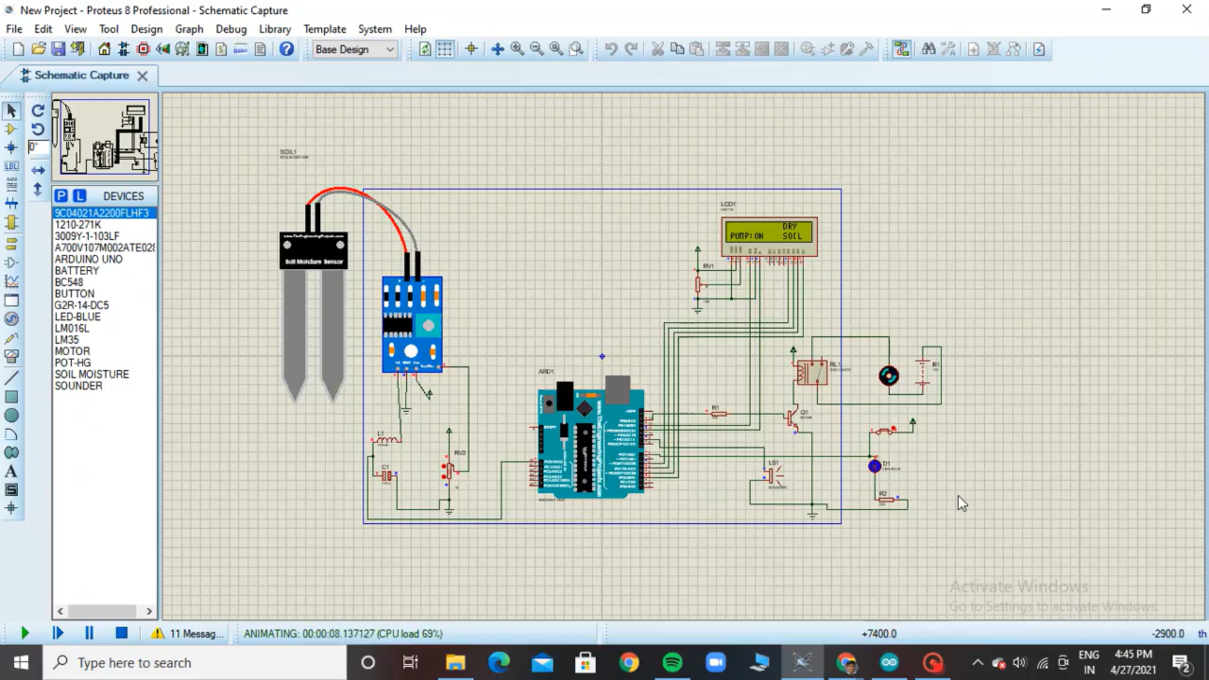
CIRCUIT AND SIMULATION

Slide 34
ARDUINO CODE:
#include <LiquidCrystal.h> //LCD Library
#define NOTE_C4 262
#define NOTE_D4 294
#define NOTE_E4 330
#define NOTE_F4 349
#define NOTE_G4 392
#define NOTE_A4 440
#define NOTE_B4 494
#define NOTE_C5 523
int temp;
int M_Sensor = A0;
int W_led = 7;
int P_led = 13;
int Speaker = 9;
int val;
int cel;
LiquidCrystal lcd(12, 11, 5, 4, 3, 2);
void setup()
{
lcd.begin(16, 2);
lcd.clear();
pinMode(13,OUTPUT);
pinMode(7,INPUT);
pinMode(9,OUTPUT);
lcd.setCursor(0,0);
lcd.setCursor(0,1);
delay(1000);
}

Slide 35
void loop()
{
lcd.clear();
int Moisture = analogRead(M_Sensor); //Read Moisture Sensor Value
if (Moisture> 700) // for dry soil
{
lcd.setCursor(11,0);
lcd.print("DRY");
lcd.setCursor(11,1);
lcd.print("SOIL");
if (digitalRead(W_led)==1)
{
digitalWrite(13, HIGH);
lcd.setCursor(0,1);
lcd.print("PUMP:ON");
}
else
{
digitalWrite(13, LOW);
lcd.setCursor(0,1);
lcd.print("PUMP:OFF");
tone(Speaker, NOTE_C4, 500);
delay(500);
tone(Speaker, NOTE_D4, 500);
delay(500);
tone(Speaker, NOTE_E4, 500);
delay(500);
tone(Speaker, NOTE_F4, 500);
delay(500);
tone(Speaker, NOTE_G4, 500);
delay(500);
}
}

Slide 36
if (Moisture>= 300 && Moisture<=700) //for Moist Soil
{
lcd.setCursor(11,0);
lcd.print("MOIST");
lcd.setCursor(11,1);
lcd.print("SOIL");
digitalWrite(13,LOW);
lcd.setCursor(0,1);
lcd.print("PUMP:OFF");
}
if (Moisture < 300) // For Soggy soil
{
lcd.setCursor(11,0);
lcd.print("SOGGY");
lcd.setCursor(11,1);
lcd.print("SOIL");
digitalWrite(13,LOW);
lcd.setCursor(0,1);
lcd.print("PUMP:OFF");
}
delay(1000);
}
}

Slide 37
TEMPERATURE SENSOR

Slide 38
WHAT IS A TEMPERATURE SENSOR?
•A temperature sensor is an electronic device that measures the temperature of its environment and converts the input data into electronic data to record, monitor, or signal temperature changes.
•There are many different types of temperature sensors. Some temperature sensors require direct contact with the physical object that is being monitored (contact temperature sensors), while others indirectly measure the temperature of an object (non-contact temperature sensors).

Slide 39
WHAT IS THE USE OF THE TEMPERATURE SENSOR IN INTEGRATED FARMING SENSOR SYSTEM?
•The main use of the Integrated Farming Sensor System is to create an environment which is rich for the cultivation of crops and farming. Creating a new age for the farmers for better and effective farming.
•It helps to sense the environmental temperature and keep it in check to create a moderate condition for effective growth of the crops.
• The temperature sensor will calculate the temperature and give the output on a digital display. The next step would be to bring the temperature back to the effective condition required; if not in that range when recorded.

Slide 40
COMPONENTS REQUIRED
•Proteus 8 professional – Online electronics lab
•Arduino IDE – For coding purpose
•Simulino Uno – Online Arduino
•NCP15XH103 – Temperature compensation 10k,100mW
•LM016L – Alphanumeric LCD
•3 WATT 10K – 10K 3W Resistor

Slide 41
CIRCUIT

Slide 42
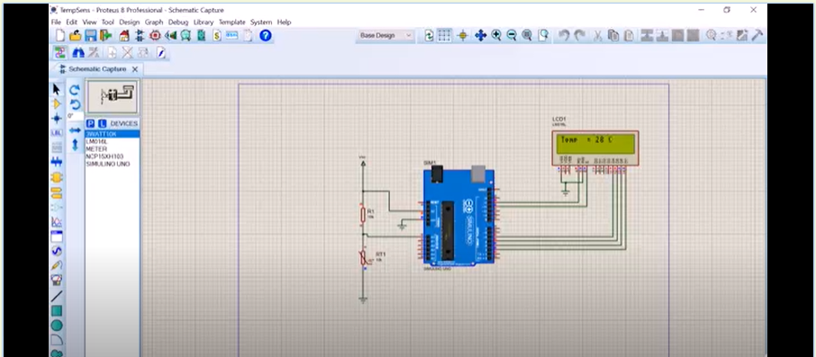
WORKING OF TEMPERATURE SENSOR SIMULATION

Slide 43
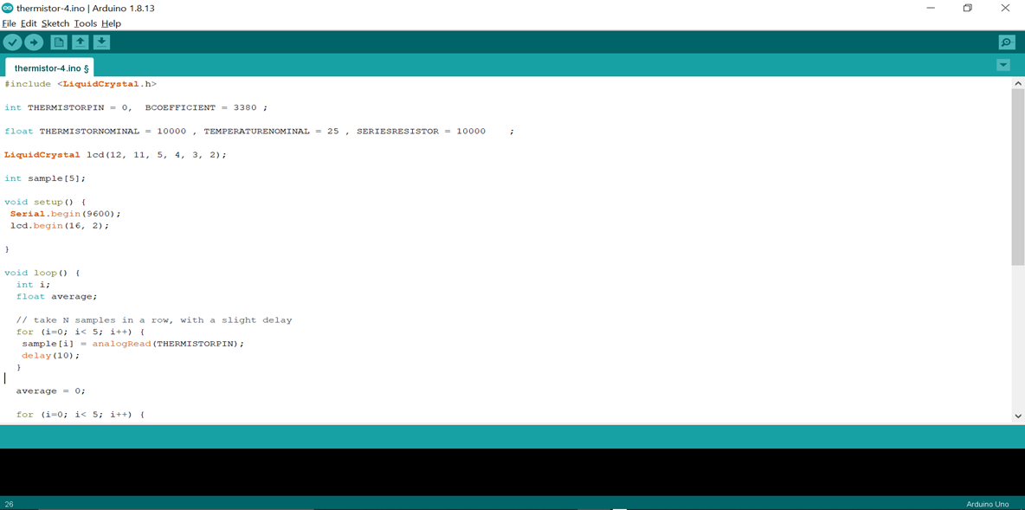
ARDUINO CODE

Slide 44
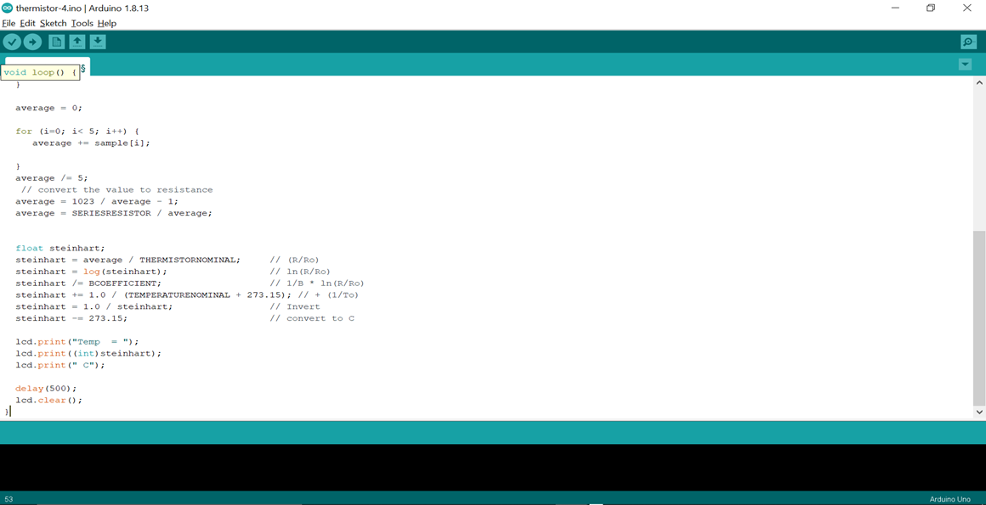

Slide 45
HUMIDITY SENSOR
BASED ON
DHT11 - DIGITAL HUMIDITY AND TEMPERATURE MODULE

Slide 46
ABOUT THE SENSOR
Humidity is the amount of water vapour present in the atmosphere.
Humidity sensor is a device which measures the humidity of the environment. A DHT11 sensor module is used to detect and display the humidity in the utilization zone. The humidity is measured as relative humidity (%) which is given by the formulae
Relative Humidity =
(Density of water vapor / Density of water vapor at saturation) x 100%
By measuring the density of water vapours humidity measurements are shown.
DHT11 module contains apparatus which includes a pair of electrodes and a substrate
Confined as a dielectric between the electrodes in it. When the module traps the atmospheric air in it, the substrate releases ions into the electrodes based on the water vapour content in the air trapped. This increases the ion concentration in the electrodes which will increase the conductivity and thus the resistance decreases.
The resistance is then converted into humidity measurement by the sensor.

Slide 47
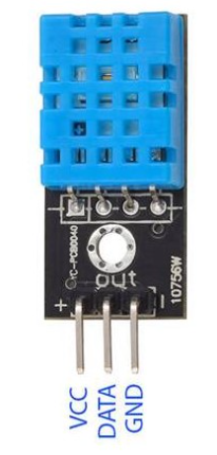
This sensor falls under the relative sensor category as the measurement of humidity is a function of the temperature (varies with temperature).
The DHT11 module is given the voltage supply between the range of 3V- 5.5V and has a digital screen to display humidity. There is a data pin which acts as the interface for data communication. The VCC pin is for the positive potential and GND pin is for the ground (0 - potential).

Slide 48
HUMIDITY FACTOR IN AGRICULTURAL YIELDS
Humidity plays a major role in agricultural productivity. Plants require adequate amount of micronutrients like calcium, etc. and most of the nutrients and the raw materials for processing food and other methods for performing life actions are dependant on the water cycle taking place inside the plant. Relative humidity for most of the plants in different soils lie under the range of 50% - 60%. Plants lose water through the pores of the leaves called stomata as vapours and absorb water as liquid from roots. When the humidity of plants are high, the plants on keeping their stomata open will affect the transpiration exchanges. VPD - Vapour Pressure Deficit is the difference in the vapour pressures of the leaf and the surroundings. In hotter regions, when the humidity is high, VPD is low and vapour tends to flow through the leaves because of pressure difference and equilibrium. Thus plants adjust their pores and this affects the regular transpiration exchanges of plants and affects the water cycle. The absorption of water and nutrients from the roots are disturbed. When VPD is high and humidity of surroundings in low, plants lose water through transpiration and under extreme conditions, this can lead to heavy water loses.

Slide 49
Thus, the stomata is closed but this influences the photosynthesis process where the carbon-di-oxide absorption is affected. Because of these fluctuations in the humidity, plants can face wilting, gluttations, curled (small) leaves, nutrient deficiencies, root diseases, etc.. Humidity conditions favour bacteria and fungus which can invade the plants along with the problem of pests and insects.
Humidity(%) of certain plants in their vegetative states is listed below:
Rice 70 - 80%
Paddy 20 - 25%
Wheat 50 - 60%
Banana plants (banyan) 50%
Humidity control processes:
Misting
Grouping
Humidification / De-humidification
Pebbles / Gravels

Slide 50
HUMIDITY SENSOR - COMPONENTS REQUIRED
SOFTWARE:
Proteus 8 Professional
Arduino 1.8.13 IDE
HARDWARE:
Arduino uno R3
DHT11 sensor module
LCD - LM016L (16x2)
Wires
5V power source (optional)

Slide 51
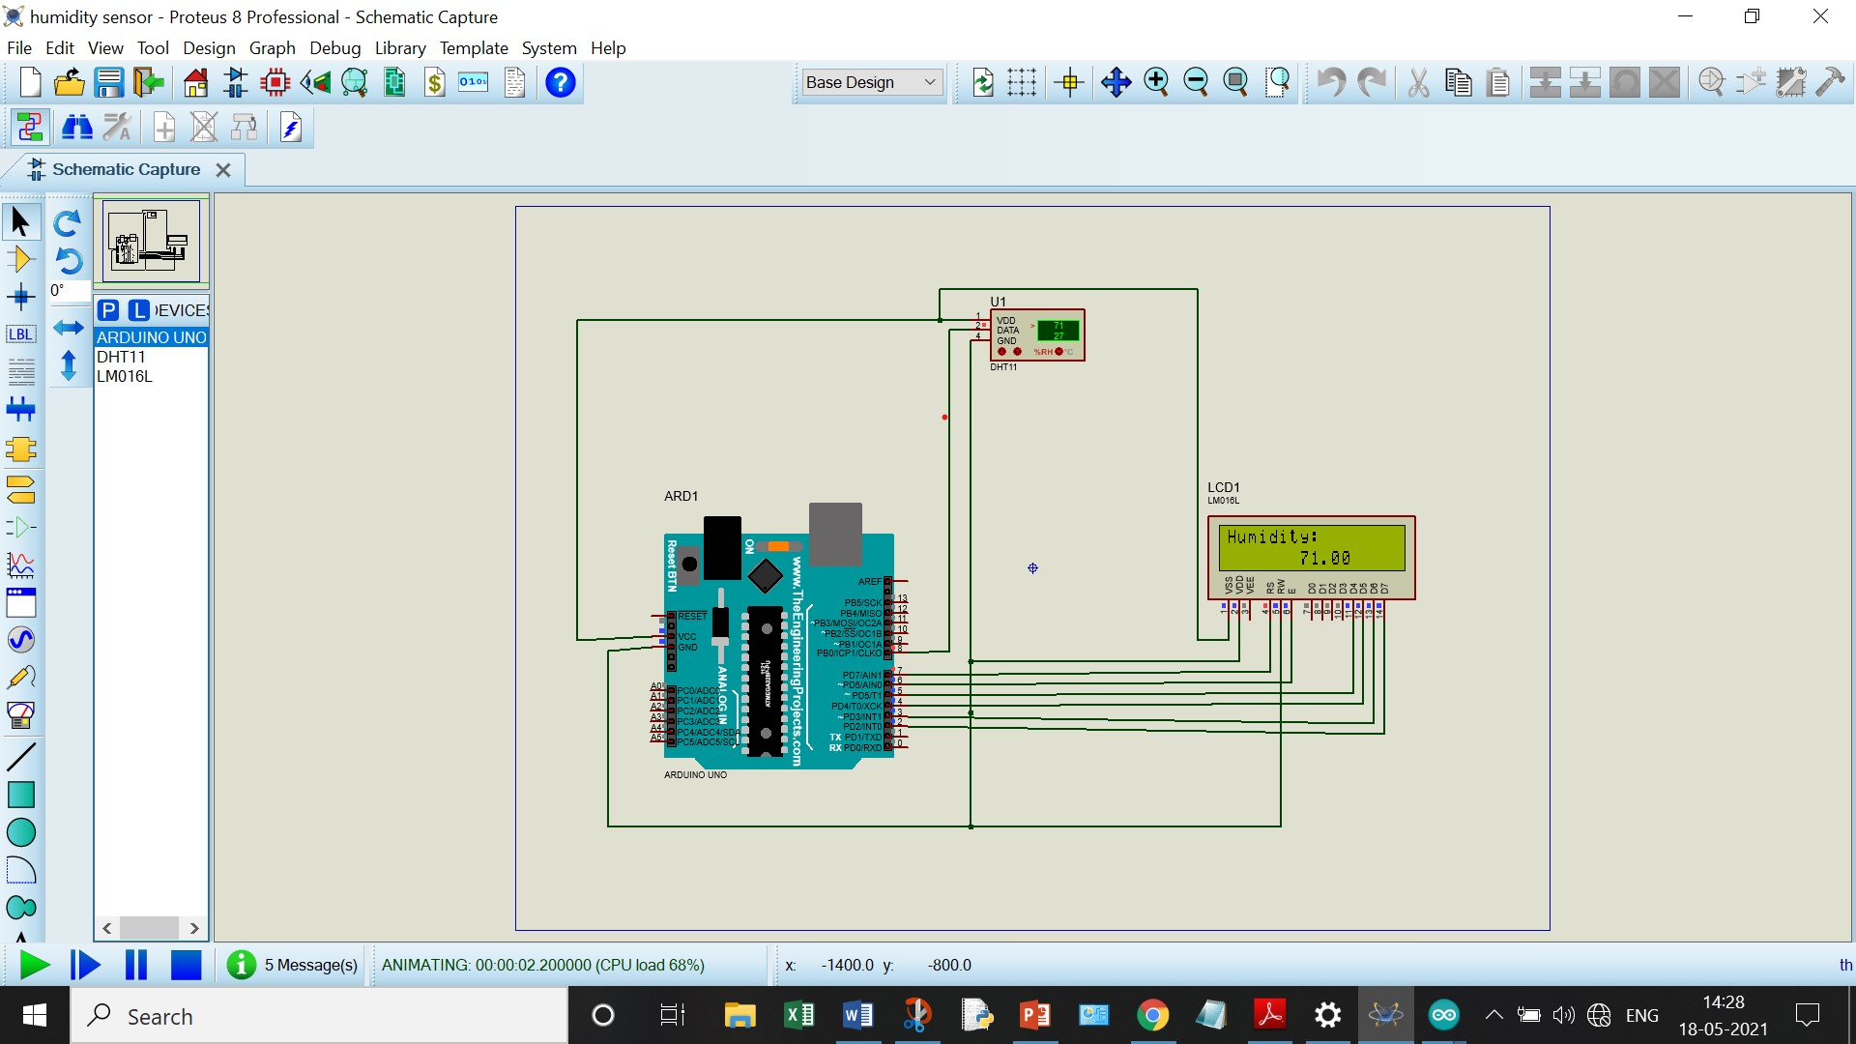

SIMULATION

Slide 52
ARDUINO CODE
#include <Adafruit_BME280.h> //include library
#include <LiquidCrystal.h> //include library
#include "DHT.h" //include library
// set the DHT Pin
#define DHTPIN 8
// initialize the library with the numbers of the interface pins
LiquidCrystal lcd(7, 6, 5, 4, 3, 2);
#define DHTTYPE DHT11
DHT dht(DHTPIN, DHTTYPE);
void setup() {
// set up the LCD's number of columns and rows:
lcd.begin(16, 2);
dht.begin();
// Print a message to the LCD.
lcd.print("Humidity:");
}

Slide 53
void loop() {
delay(500);
// set the cursor to column 0, line 1
// line 1 is the second row, since counting begins with 0)
lcd.setCursor(0, 1);
// read humidity
float h = dht.readHumidity();
if (isnan(h)) {
lcd.print("ERROR");
return;
}
lcd.setCursor(7,1);
lcd.print(h) ;
}

Slide 54
pH SENSOR

Slide 55
pH SENSOR
• pH sensors measure the level of pH in sample solutions by measuring the activity of the hydrogen ions in the solutions. This activity is compared to pure water (a neutral solution) using a pH scale of 0 to 14 to determine the acidity or alkalinity of the sample solutions.
•pH sensors are used for soil measurements in agriculture, water quality for municipal water supplies, swimming pools, environmental remediation; brewing of wine or beer; manufacturing, healthcare and clinical applications such as blood chemistry; and many other applications.

Slide 56
Uses of pH sensor in Integrated farming sensor system
•The availability of nutrients is as essential to plant. In optimizing a plant's growth potential and yielding highly productive harvests, it's imperative to have a deep and quantitative understanding of the soil conditions from which agricultural products come.
•Soil content and quality is a key factor of crop health. Physically, soil material and density affects water infiltration and retention. Chemically, pH of soil affects nutrient availability and uptake. Biologically, enzyme content and bacterial content relate to the ability of soil to recycle nutrients and resist disturbance. While some soil characteristics are permanent qualities of a soil, and therefore part of soil selection criteria, others can be controlled and optimized. The best way to start the process of improving soil health is by measuring soil using a soil pH sensor.
•Using pH sensors provides critical feedback regarding soil nutrient deficiencies or the presence of unwanted chemicals. These sensors help smart agriculture monitor daily, weekly, monthly and annual fluctuations in soil pH and nutrient levels to continue to educate the agricultural industry.

Slide 57
Components required
Proteus 8 professional
PIC16F877A - Microcontroller
POT-HG - Potentiometer
LM016L - Alphanumeric LCD
RES - 10k Resistor

Slide 58
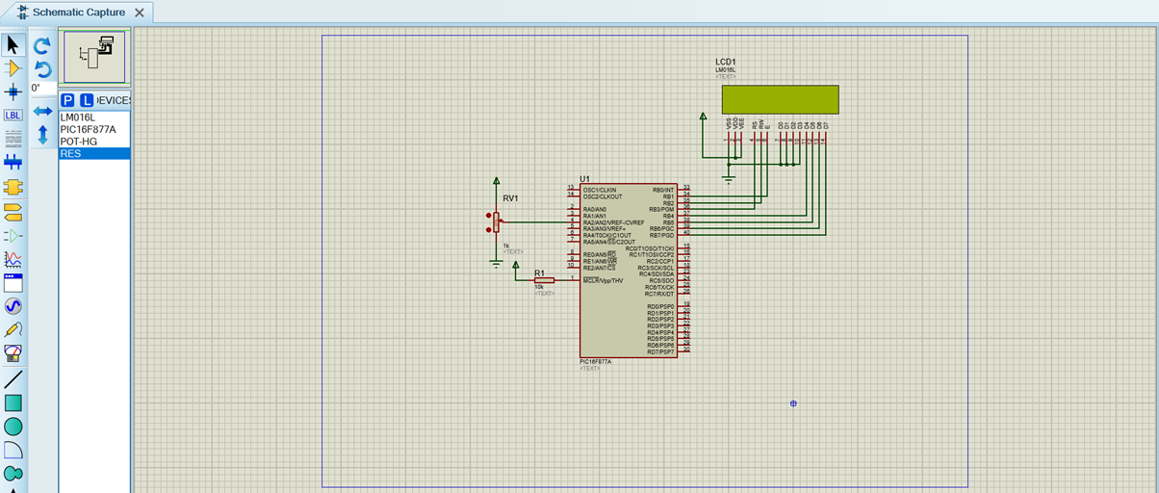
Circuit Diagram

Slide 59
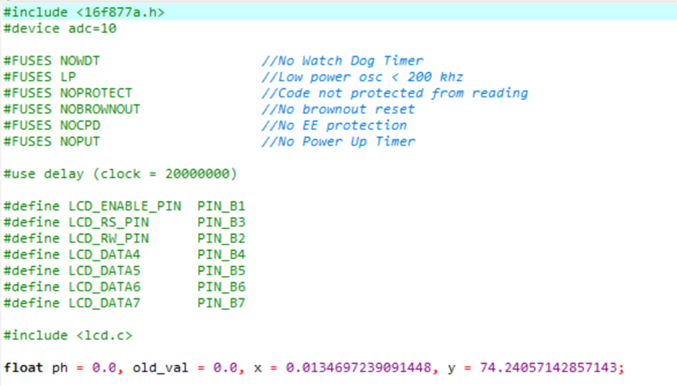
Code :-

Slide 60
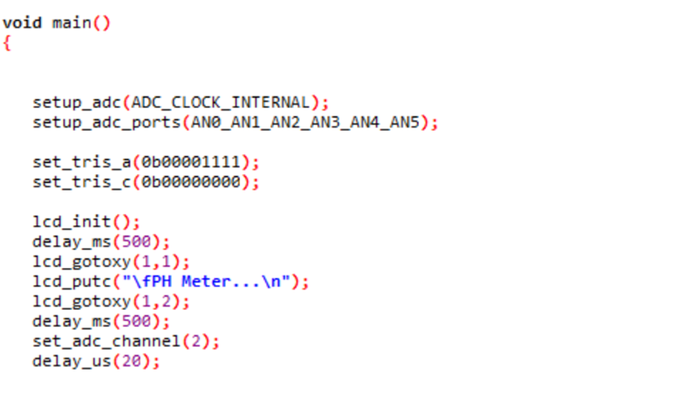

Slide 61
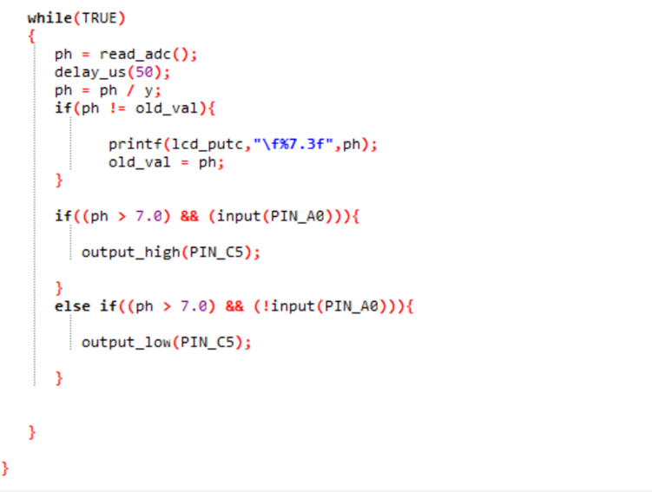

Slide 62
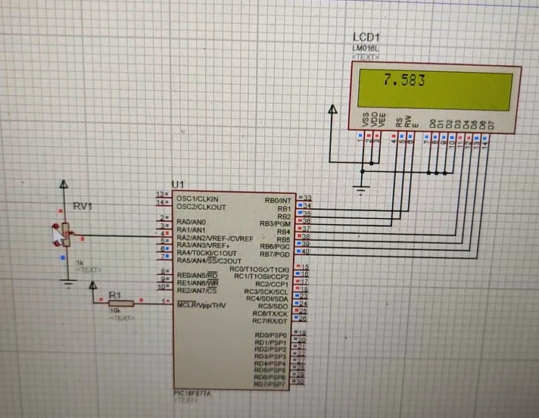
Working of pH sensor

Slide 63
THANK YOU

